Slide 1
CHAPTER 8 Corporate Strategy: Diversification and the Multibusiness Company

Slide 2
LEARNING OBJECTIVES
THIS CHAPTER WILL HELP YOU UNDERSTAND:
When and how business diversification can enhance shareholder value
How related diversification strategies can produce cross-business strategic fit capable of delivering competitive advantage
The merits and risks of unrelated diversification strategies
The analytic tools for evaluating a company’s diversification strategy
What four main corporate strategy options a diversified company can employ for solidifying its strategy and improving company performance

Slide 3
WHAT DOES CRAFTING A DIVERSIFICATION STRATEGY ENTAIL?
Step 1 | Picking new industries to enter and deciding on the means of entry
Step 2 | Pursuing opportunities to leverage cross-business value chain relationships and strategic fit into competitive advantage
Step 3 | Establishing investment priorities and steering corporate resources into the most attractive business units
Notes:
3

Slide 4
STRATEGIC DIVERSIFICATION OPTIONS
Sticking closely with the existing business lineup and pursuing opportunities presented by these businesses
Broadening the current scope of diversification by entering additional industries
Retrenching to a narrower scope of diversification by divesting poorly performing businesses
Broadly restructuring the entire firm by divesting some businesses and acquiring others to put a whole new face on the firm’s business lineup

Slide 5
WHEN TO CONSIDER DIVERSIFYING
A firm should consider diversifying when:
Growth opportunities are limited as its principal markets reach their maturity and buyer demand is either stagnating or set to decline.
Changing industry conditions—new technologies, inroads being made by substitute products, fast-shifting buyer preferences, or intensifying competition—are undermining the firm’s competitive position.

Slide 6
HOW MUCH DIVERSIFICATION?
Deciding how wide-ranging diversification should be
Diversify into closely related businesses or into totally unrelated businesses?
Diversify present revenue and earnings base to a small or major extent?
Move into one or two large new businesses or a greater number of small ones?
Acquire an existing company?
Start up a new business from scratch?
Form a joint venture with one or more companies to enter new businesses?

Slide 7
OPPORTUNITY FOR DIVERSIFYING
Strategic diversification possibilities
Expand into businesses whose technologies and products complement present business(es).
Employ current resources and capabilities as valuable competitive assets in other businesses.
Reduce overall internal costs by cross-business sharing or transfers of resources and capabilities.
Extend a strong brand name to the products of other acquired businesses to help drive up sales and profits of those businesses.

Slide 8



BUILDING SHAREHOLDER VALUE: THE ULTIMATE JUSTIFICATION FOR DIVERSIFYING
Testing Whether Diversification Will Add Long-Term Value for Shareholders
The industry attractiveness test
The cost-of-entry test
The better-off test
Jump to Appendix 1 long image description

Slide 9
THREE TESTS FOR BUILDING SHAREHOLDER VALUE THROUGH DIVERSIFICATION
The attractiveness test
Are the industry’s profits and return on investment as good or better than present business(es)?
The cost of entry test
Is the cost of overcoming entry barriers so great as to long delay or reduce the potential for profitability?
The better-off test
How much synergy (stronger overall performance) will be gained by diversifying into the industry?

Slide 10
Strategic Management Principle (1 of 9)
To add shareholder value, diversification into a new business must pass the three tests of corporate advantage
The industry attractiveness test
The cost of entry test
The better-off test

Slide 11
Core Concept (1 of 15)
Creating added value for shareholders via diversification requires building a multibusiness company in which the whole is greater than the sum of its parts; such 1 + 1= 3 effects are called synergy.

Slide 12



BETTER PERFORMANCE THROUGH SYNERGY
Firm A purchases Firm B in another industry. A and B’s profits are no greater than what each firm could have earned on its own.
No Synergy (1+1=2)
Evaluating the Potential for Synergy through Diversification
Firm A purchases Firm C in another industry. A and C’s profits are greater than what each firm could have earned on its own.
Synergy (1+1=3)
Jump to Appendix 2 long image description

Slide 13
APPROACHES TO DIVERSIFYING THE BUSINESS LINEUP
Diversifying into New Businesses
Existing business acquisition
Internal new venture (start-up)
Joint venture
Jump to Appendix 3 long image description

Slide 14
DIVERSIFICATION BY ACQUISITION OF AN EXISTING BUSINESS
Advantages:
Quick entry into an industry
Barriers to entry avoided
Access to complementary resources and capabilities
Disadvantages:
Cost of acquisition—whether to pay a premium for a successful firm or seek a bargain in a struggling firm
Underestimating costs for integrating acquired firm
Overestimating the acquisition’s potential to deliver added shareholder value

Slide 15
Core Concept (2 of 15)
An acquisition premium, or control premium, is the amount by which the price offered exceeds the preacquisition market value of the target company.

Slide 16
ENTERING A NEW LINE OF BUSINESS THROUGH INTERNAL DEVELOPMENT
Advantages of new venture development
Avoids pitfalls and uncertain costs of acquisition
Allows entry into a new or emerging industry where there are no available acquisition candidates
Disadvantages of intrapreneurship
Must overcome industry entry barriers
Requires extensive investments in developing production capacities and competitive capabilities
May fail due to internal organizational resistance to change and innovation

Slide 17
Core Concept (3 of 15)
Corporate venturing, or new venture development, is the process of developing new businesses as an outgrowth of a firm’s established business operations. It is also referred to as corporate entrepreneurship or intrapreneurship since it requires entrepreneurial-like qualities within a larger enterprise.

Slide 18

WHEN TO ENGAGE IN INTERNAL DEVELOPMENT
Ample time to develop and launch business
Availability of in-house skills and resources
Cost of acquisition higher than internal entry
Factors Favoring Internal Development
Low resistance of incumbent firms to market entry
Added capacity affects supply and demand balance
Jump to Appendix 4 long image description

Slide 19


WHEN TO ENGAGE IN A JOINT VENTURE
Is the opportunity too complex, uneconomical, or risky for one firm to pursue alone?
Evaluating the Potential for a Joint Venture
Does the opportunity require a broader range of competencies and know-how than the firm now possesses?
Will the opportunity involve operations in a country that requires foreign firms to have a local minority or majority ownership partner?
Jump to Appendix 5 long image description

Slide 20
USING JOINT VENTURES TO ACHIEVE DIVERSIFICATION
Joint ventures are advantageous when diversification opportunities:
Are too large, complex, uneconomical, or risky for one firm to pursue alone
Require a broader range of competencies and know-how than a firm possesses or can develop quickly
Are located in a foreign country that requires local partner participation or ownership

Slide 21
DIVERSIFICATION BY JOINT VENTURE
Joint ventures have the potential for developing serious drawbacks due to:
Conflicting objectives and expectations of venture partners
Disagreements among or between venture partners over how best to operate the venture
Cultural clashes among and between the partners
Dissolution of the venture when one of the venture partners decides to go their own way

Slide 22
CHOOSING A MODE OF MARKET ENTRY
The Question of Critical Resources and Capabilities | Does the firm have the resources and capabilities for internal development?
The Question of Entry Barriers | Are there entry barriers to overcome?
The Question of Speed | Is speed of the essence in the firm’s chances for successful entry?
The Question of Comparative Cost | Which is the least costly mode of entry, given the firm’s objectives?

Slide 23
Core concept (4 of 15)
Transaction costs are the costs of completing a business agreement or deal of some sort, over and above the price of the deal. They can include the costs of searching for an attractive target, the costs of evaluating its worth, bargaining costs, and the costs of completing the transaction.

Slide 24
CHOOSING THE DIVERSIFICATION PATH: RELATED VERSUS UNRELATED BUSINESSES
Which Diversification Path to Pursue?
Related Businesses
Unrelated Businesses
Both Related and Unrelated Businesses

Slide 25
Core Concepts (5 of 15)
Related businesses possess competitively valuable cross-business value chain and resource matchups.
Unrelated businesses have dissimilar value chains and resource requirements, with no competitively important cross-business relationships at the value chain level.

Slide 26
Core Concept (6 of 15)
Strategic fit exists whenever one or more activities constituting the value chains of different businesses are sufficiently similar in present opportunities for cross-business sharing or transferring of the resources and capabilities that enable these activities.

Slide 27
DIVERSIFICATION INTO RELATED BUSINESSES
Strategic fit opportunities
Transferring specialized expertise, technological know-how, or other resources and capabilities from one business’s value chain to another’s
Sharing costs by combining related value chain activities into a single operation
Exploiting common use of a well-known brand name
Sharing other resources (besides brands) that support corresponding value chain activities across businesses
Engaging in cross-business collaboration and knowledge sharing to create new competitively valuable resources and capabilities

Slide 28
PURSUING RELATED DIVERSIFICATION
Generalized resources and capabilities:
Can be deployed widely across a broad range of industry and business types
Can be leveraged in both unrelated and related diversification situations
Specialized resources and capabilities:
Have very specific applications which restrict their use to a narrow range of industry and business types
Can typically be leveraged only in related diversification situations

Slide 29
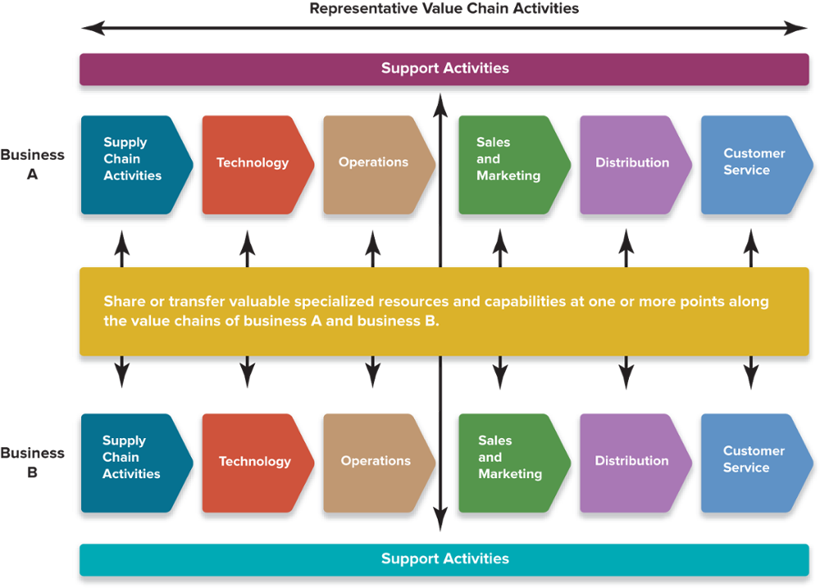
FIGURE 8.1 Related Businesses Provide Opportunities to Benefit from Competitively Valuable Strategic Fit
Jump to Appendix 6 long image description

Slide 30
IDENTIFYING CROSS-BUSINESS STRATEGIC FITS ALONG THE VALUE CHAIN
Supply chain activities
R&D and technology activities
Manufacturing-related activities
Potential Cross-Business Fits
Sales and marketing activities
Distribution-related activities
Customer service activities
Jump to Appendix 7 long image description

Slide 31

STRATEGIC FIT, ECONOMIES OF SCOPE, AND COMPETITIVE ADVANTAGE
Using Economies of Scope to Convert Strategic Fit into Competitive Advantage
Transferring specialized and generalized skills or knowledge
Combining related value chain activities to achieve lower costs
Leveraging brand names and other differentiation resources
Using cross-business collaboration and knowledge sharing
Jump to Appendix 8 long image description

Slide 32
Core Concepts (7 of 15)
Economies of scope are cost reductions that flow from operating in multiple businesses (a larger scope of operation).
Economies of scale accrue from a larger-size operation.

Slide 33
ECONOMIES OF SCOPE DIFFER FROM ECONOMIES OF SCALE
Economies of scope
Are cost reductions that flow from cross-business resource sharing in the activities of the multiple businesses of a firm
Economies of scale
Accrue when unit costs are reduced due to the increased output of larger-size operations of a firm

Slide 34
FROM STRATEGIC FIT TO COMPETITIVE ADVANTAGE, ADDED PROFITABILITY AND GAINS IN SHAREHOLDER VALUE
Capturing the Cross-Business Strategic-Fit Benefits of Related Diversification
Builds more shareholder value than owning a stock portfolio
Only possible via a strategy of related diversification
Yields value in the application of specialized resources and capabilities
Requires that management take internal actions to realize them
Jump to Appendix 9 long image description

Slide 35
Strategic Management Principle (3 of 9)
Diversifying into related businesses where competitively valuable strategic-fit benefits can be captured puts a firm’s businesses in position to perform better financially as part of the firm than they could have performed as independent enterprises, thus providing a clear avenue for boosting shareholder value and satisfying the better-off test.

Slide 36
THE EFFECTS OF CROSS-BUSINESS FIT
Fit builds more value than owning a stock portfolio of firms in different industries
Strategic-fit benefits are possible only via related diversification
The stronger the fit, the greater its effect on the firm’s competitive advantages
Fit fosters the spreading of competitively valuable resources and capabilities specialized to certain applications and that have value only in specific types of industries and businesses

Slide 37
The Kraft-Heinz Merger: Pursuing the Benefits of Cross-Business Strategic Fit
Why did Kraft choose to seek a merger with Heinz rather than starting its own food products subsidiary?
What are the anticipated results of the merger?
To what extent is decentralization required when seeking cross-business strategic fit?
What should Kraft-Heinz do to ensure the continued success of its related diversification strategy?

Slide 38
DIVERSIFICATION INTO UNRELATED BUSINESSES
Can it meet corporate targets for profitability and return on investment?
Evaluating the acquisition of a new business or the divestiture of an existing business
Is it in an industry with attractive profit and growth potentials?
Is it is big enough to contribute significantly to the parent firm’s bottom line?
Jump to Appendix 10 long image description

Slide 39
BUILDING SHAREHOLDER VALUE VIA UNRELATED DIVERSIFICATION
Using an Unrelated Diversification Strategy to Pursue Value
Astute corporate parenting by management
Cross-business allocation of financial resources
Acquiring and restructuring undervalued companies
Jump to Appendix 11 long image description

Slide 40
BUILDING SHAREHOLDER VALUE VIA UNRELATED DIVERSIFICATION
Astute corporate parenting by management | Provide leadership, oversight, expertise, and guidance Provide generalized or parenting resources that lower operating costs and increase SBU efficiencies
Cross-business allocation of financial resources | Serve as an internal capital market Allocate surplus cash flows from businesses to fund the capital requirements of other businesses
Acquiring and restructuring undervalued companies | Acquire weakly performing firms at bargain prices Use turnaround capabilities to restructure them to increase their performance and profitability

Slide 41
Core Concept (8 of 15)
Corporate parenting is the role that a diversified corporation plays in nurturing its component businesses through the provision of:
Top management expertise
Disciplined control
Financial resources
Other types of generalized resources and capabilities such as long-term planning systems, business development skills, management development processes, and incentive systems

Slide 42
Core Concept (9 of 15)
A diversified firm has a parenting advantage when it is more able than other firms to boost the combined performance of its individual businesses through high-level guidance, general oversight, and other corporate-level contributions.

Slide 43
Strategic Management Principle (4 of 9)
An umbrella brand is a corporate brand name that can be applied to a wide assortment of business types. As such, it is a generalized resource that can be leveraged in unrelated diversification.

Slide 44
Core Concept (10 of 15)
Restructuring refers to overhauling and streamlining the activities of a business: combining plants with excess capacity, selling off underutilized assets, reducing unnecessary expenses, and otherwise improving the productivity and profitability of the firm.

Slide 45
THE PATH TO GREATER SHAREHOLDER VALUE THROUGH UNRELATED DIVERSIFICATION
Diversify into businesses that can produce consistently good earnings and returns on investment
The attractiveness test
Actions taken by upper management to create value and gain a parenting advantage
The cost-of-entry test
Negotiate favorable acquisition prices
Provide managerial oversight and resource sharing, financial resource allocation and portfolio management, and restructure underperforming businesses
The better-off test
Jump to Appendix 12 long image description

Slide 46




THE DRAWBACKS OF UNRELATED DIVERSIFICATION
Demanding Managerial Requirements
Pursuing an Unrelated Diversification Strategy
Limited Competitive Advantage Potential
Monitoring and maintaining the parenting advantage
Potential lack of cross-business strategic-fit benefits
Jump to Appendix 13 long image description

Slide 47
MISGUIDED REASONS FOR PURSUING UNRELATED DIVERSIFICATION
Poor Rationales for Unrelated Diversification
Seeking a reduction of business investment risk
Pursuing rapid or continuous growth for its own sake
Seeking stabilization to avoid cyclical swings in businesses
Pursuing personal managerial motives
Jump to Appendix 14 long image description

Slide 48
STRATEGIC MANAGEMENT PRINCIPLE (5 of 9)
Relying solely on leveraging general resources and the expertise of corporate executives to wisely manage a set of unrelated businesses is a much weaker foundation for enhancing shareholder value than is a strategy of related diversification.
Only profitable growth—the kind that comes from creating added value for shareholders—can justify a strategy of unrelated diversification.

Slide 49
COMBINATION RELATED-UNRELATED DIVERSIFICATION STRATEGIES
Related-Unrelated Business Portfolio Combinations
Dominant-business enterprises
Narrowly diversified firms
Broadly diversified firms
Multi-business enterprises
Jump to Appendix 15 long image description

Slide 50
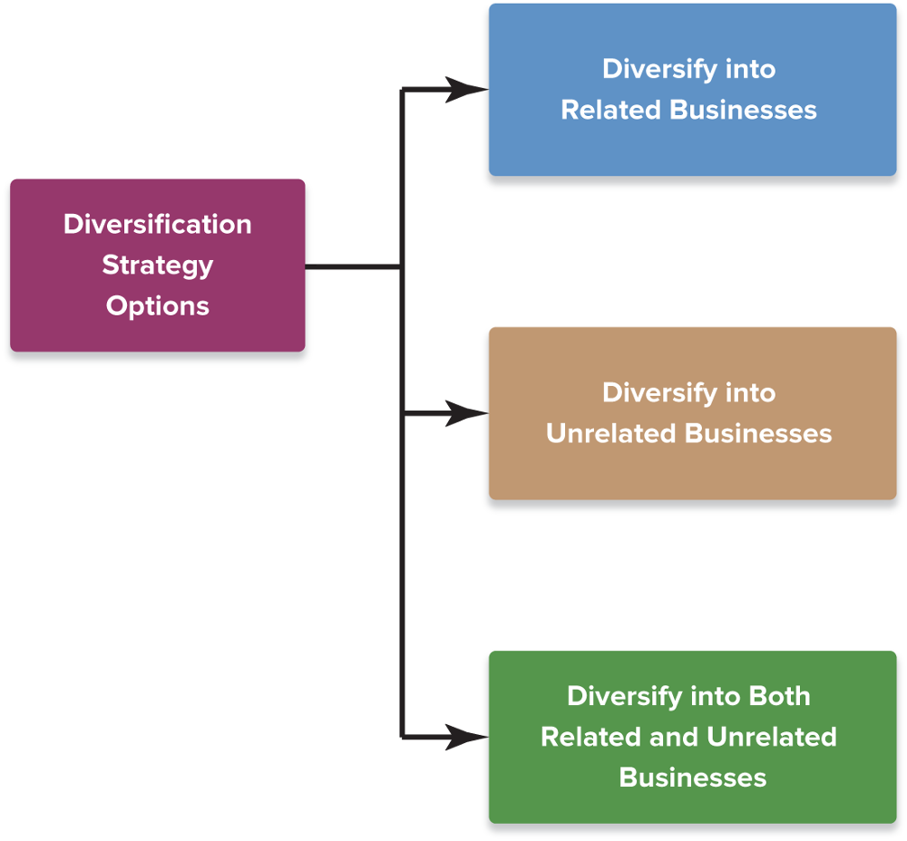
FIGURE 8.2 Three Strategy Options for Pursuing Diversification
Jump to Appendix 17 long image description

Slide 51
STRUCTURES OF COMBINATION RELATED-UNRELATED DIVERSIFIED FIRMS
Dominant-business enterprises:
Have a major “core” firm that accounts for 50 to 80% of total revenues and a collection of small related or unrelated firms that accounts for the remainder
Narrowly diversified firms:
Are comprised of a few related or unrelated businesses
Broadly diversified firms:
Have a wide-ranging collection of related businesses, unrelated businesses, or a mixture of both
Multibusiness enterprises:
Have a business portfolio consisting of several unrelated groups of related businesses

Slide 52

EVALUATING THE STRATEGY OF A DIVERSIFIED COMPANY
Attractiveness of industries
Strength of business units
Cross-business strategic fit
Diversified Strategy
Fit of firm’s resources
Allocation of resources
New strategic moves
Jump to Appendix 16 long image description

Slide 53
STEPS IN EVALUATING THE STRATEGY OF A DIVERSIFIED FIRM
Assess the attractiveness of the industries the firm has diversified into, both individually and as a group
Assess the competitive strength of the firm’s business units within their respective industries
Evaluate the extent of cross-business strategic fit along the value chains of the firm’s various business units
Check whether the firm’s resources fit the requirements of its present business lineup
Rank the performance prospects of the businesses from best to worst and determine resource allocation priorities
Craft strategic moves to improve corporate performance

Slide 54
STEP 1: EVALUATING INDUSTRY ATTRACTIVENESS
How attractive are the industries in which the firm has business operations?
1. Does each industry represent a good market for the firm to be in?
2. Which industries are most attractive, and which are least attractive?
3. How appealing is the whole group of industries?
Jump to Appendix 18 long image description

Slide 55
CALCULATING INDUSTRY-ATTRACTIVENESS SCORES: KEY MEASURES
Market size and projected growth rate
The intensity of competition among market rivals
Emerging opportunities and threats
The presence of cross-industry strategic fit
Resource requirements
Social, political, regulatory, environmental factors
Industry profitability

Slide 56
CALCULATING INDUSTRY ATTRACTIVENESS FROM THE MULTI-BUSINESS PERSPECTIVE
The question of cross-industry strategic fit | How well do the industry’s value chain and resource requirements match up with the value chain activities of other industries in which the firm has operations?
The question of resource requirements | Do the resource requirements for an industry match those of the parent firm or are they otherwise within the company’s reach?

Slide 57
CALCULATING INDUSTRY ATTRACTIVENESS SCORES
Deciding on appropriate weights for industry attractiveness measures
Evaluating Industry Attractiveness
Gaining sufficient knowledge of the industry to assign accurate and objective ratings
Whether to use different weights for different business units whenever the importance of strength measures differs significantly from business to business
Jump to Appendix 19 long image description

Slide 58
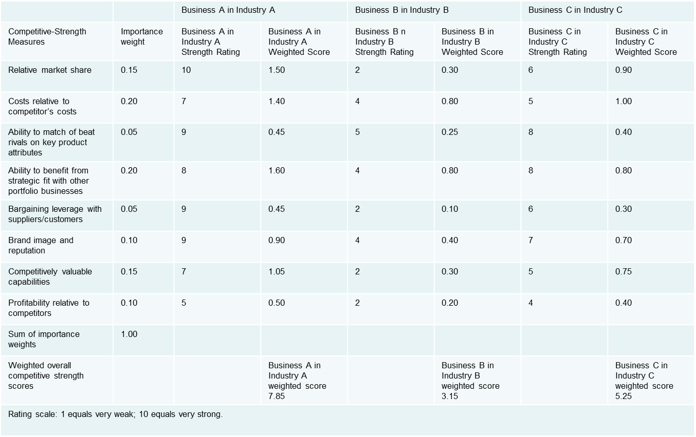
TABLE 8.1 Calculating Weighted Industry-Attractiveness Scores
Remember: The more intensely competitive an industry is, the lower the attractiveness rating for that industry!
Jump to Appendix 20 long image description

Slide 59
STEP 2: EVALUATING BUSINESS-UNIT COMPETITIVE STRENGTH
Relative market share
Costs relative to competitors’ costs
Ability to match or beat rivals on key product attributes
Brand image and reputation
Other competitively valuable resources and capabilities
Benefits from strategic fit with firm’s other businesses
Bargaining leverage with key suppliers or customers
Profitability relative to competitors

Slide 60
Strategic Management Principle (6 of 9)
Using relative market share to measure competitive strength is analytically superior to using straight-percentage market share.
Relative market share is the ratio of a business unit’s market share to the market share of its largest industry rival as measured in unit volumes, not dollars.

Slide 61
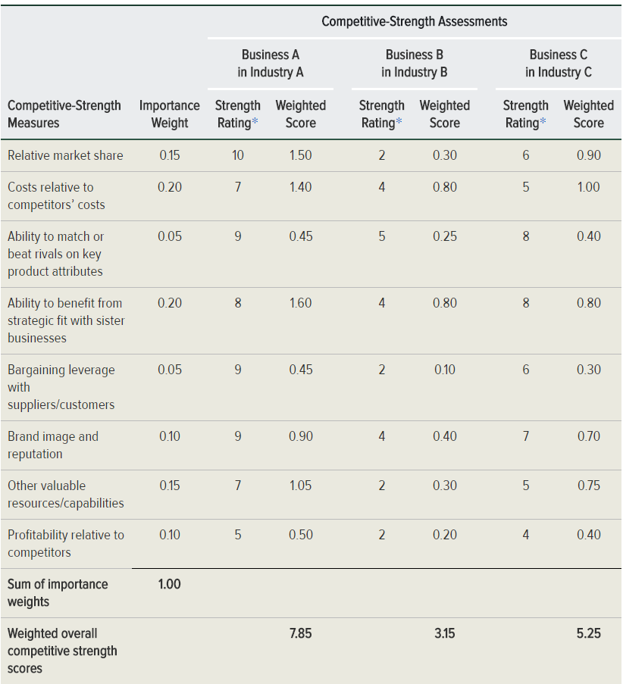
TABLE 8.2 Calculating Weighted Competitive-Strength Scores for a Diversified Company’s Business Units
Jump to Appendix 21 long image description

Slide 62
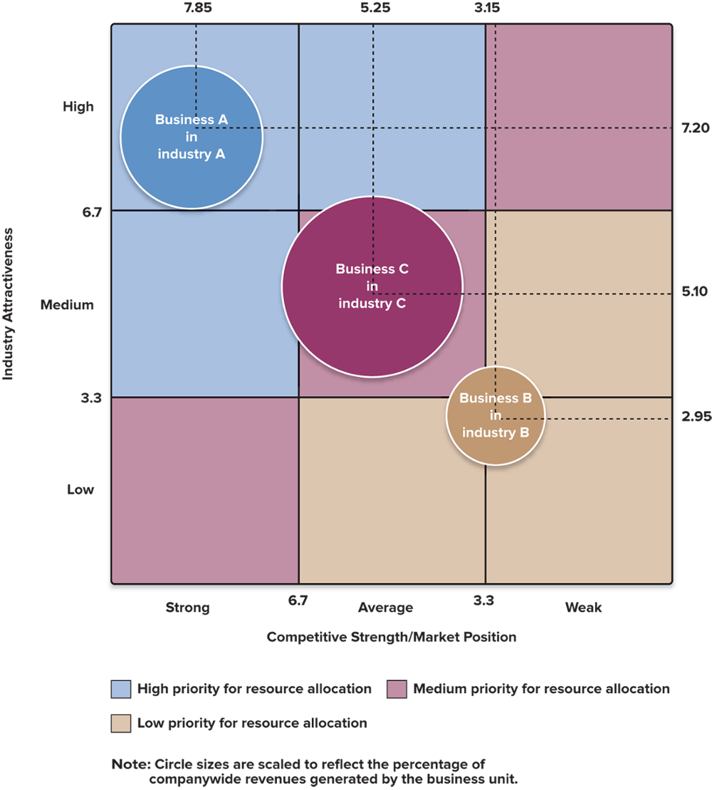
FIGURE 8.3 A Nine-Cell Industry Attractiveness–Competitive Strength Matrix
Jump to Appendix 22 long image description

Slide 63
STEP 3: DETERMINING THE COMPETITIVE VALUE OF STRATEGIC FIT IN DIVERSIFIED COMPANIES
Assessing the degree of strategic fit across its businesses is central to evaluating a company’s related diversification strategy.
The real test of a diversification strategy is what degree of competitive value can be generated from strategic fit.

Slide 64
STRATEGIC MANAGEMENT PRINCIPLE (7 of 9)
The greater the value of cross-business strategic fit in enhancing a firm’s performance in the marketplace or on the bottom line, the more competitively powerful is its strategy of related diversification.

Slide 65
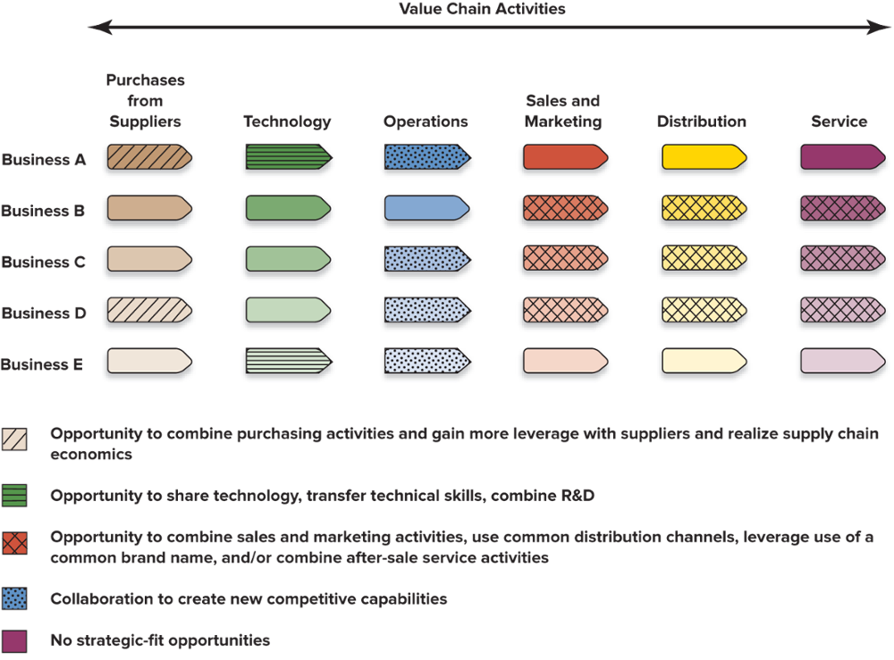
FIGURE 8.4 Identifying the Competitive Advantage Potential of Cross-Business Strategic Fit
Jump to Appendix 23 long image description

Slide 66
Core Concepts (11 of 15)
A company pursuing related diversification exhibits resource fit when its businesses have matching specialized resource requirements along their value chains.
A company pursuing unrelated diversification has resource fit when the parent company has adequate corporate resources (parenting and general resources) to support its businesses’ needs and to add value.

Slide 67
STEP 4: CHECKING FOR RESOURCE FIT
Financial resource fit
State of the internal capital market
Using the portfolio approach:
Cash hogs need cash to develop.
Cash cows generate excess cash.
Star businesses are self-supporting.
Success sequence:
Cash hog ➔ Star ➔ Cash cow
Nonfinancial resource fit
Does the firm have (or can it develop) the specific resources and capabilities needed to be successful in each of its businesses?
Are the firm’s resources being stretched too thin by the resource requirements of one or more of its businesses?

Slide 68
Core Concept (12 of 15)
A strong internal capital market allows a diversified firm to add value by shifting capital from business units generating free cash flow to those needing additional capital to expand and realize their growth potential.
A portfolio approach to ensuring financial fit among a firm’s businesses is based on the fact that different businesses have different cash flow and investment characteristics.

Slide 69
Core Concepts (13 of 15)
A cash cow business generates cash flows over and above its internal requirements, thus providing a corporate parent with funds for investing in cash hog businesses, financing new acquisitions, or paying dividends.
A cash hog business generates cash flows that are too small to fully fund its operations and growth and requires cash infusions to provide additional working capital and finance new capital investment.

Slide 70
STEP 5: RANKING BUSINESS UNITS AND ASSIGNING A PRIORITY FOR RESOURCE ALLOCATION
Ranking factors
Sales growth
Profit growth
Contribution to company earnings
Return on capital invested in the business
Cash flow
Steer resources to business units with the brightest profit and growth prospects and solid strategic and resource fit

Slide 71
The Chief Strategic and Financial Options for Allocating a Diversified Company’s Financial Resources
Strategic options
Invest in ways to strengthen or grow existing business
Make acquisitions to establish positions in new industries or to complement existing businesses
Fund long-range R&D ventures aimed at opening market opportunities in new or existing businesses
Financial options
Pay off existing long-term or short-term debt
Increase dividend payments to shareholders
Repurchase shares of the company’s common stock
Build cash reserves; invest in short-term securities

Slide 72
STEP 6: CRAFTING NEW STRATEGIC MOVES TO IMPROVE OVERALL CORPORATE PERFORMANCE
Strategy Options for a Firm That Is Already Diversified
Stick with the existing business lineup
Broaden the diversification base with new acquisitions
Divest and retrench to a narrower diversification base
Restructure through divestitures and acquisitions
Jump to Appendix 24 long image description

Slide 73
A Firm’s Strategic Alternatives After It Diversifies
Undiversified firm
Maintain existing business lineup
Makes sense when the current business lineup offers attractive growth opportunities and can generate added economic value for shareholders
Broaden diversification base
Acquire more businesses and build positions in new related or unrelated industries
Add businesses that will complement and strengthen the market position and competitive capabilities of businesses in industries where the firm already has a stake
Diversified firm
Narrow diversification base
Get out of businesses that are competitively weak or in unattractive industries, or lack adequate strategic and resource fit
Focus resources on businesses in a few select industry arenas
Restructure the firm’s business lineup through a mix of divestitures and new acquisitions
Use debt capacity and cash from divesting businesses that are in unattractive industries, or that lack strategic or resource fit and are noncore businesses to make acquisitions in more promising industries

Slide 74
BROADENING A DIVERSIFIED FIRM’S BUSINESS BASE
Factors motivating the addition of businesses
The transfer of resources and capabilities to related or complementary businesses
Rapidly changing technology, legislation, or new product innovations in core businesses
Shoring up the market position and competitive capabilities of the firm’s present businesses
Extension of the scope of the firm’s operations into additional country markets

Slide 75
DIVESTING BUSINESSES AND RETRENCHING TO A NARROWER DIVERSIFICATION BASE
Factors motivating business divestitures
Long-term performance can be improved by concentrating on stronger positions in fewer core businesses and industries.
Business is in a once-attractive industry where market conditions have badly deteriorated
Business has either failed to perform as expected or is lacking in cultural, strategic, or resource fit.
Business has become more valuable if sold to another firm or as an independent spin-off firm.

Slide 76
Core Concept (14 of 15)
A spinoff is an independent company created when a corporate parent divests a business either by selling shares to the public via an initial public offering or by distributing shares in the new company to shareholders of the corporate parent.

Slide 77
STRATEGIC MANAGEMENT PRINCIPLE (8 of 9)
Diversified companies need to divest low-performing businesses or businesses that do not fit in order to concentrate on expanding existing businesses and entering new ones where opportunities are more promising.

Slide 78
RESTRUCTURING A DIVERSIFIED COMPANY’S BUSINESS LINEUP
Factors leading to corporate restructuring
A serious mismatch between the firm’s resources and capabilities and the type of diversification that it has pursued
Too many businesses in slow-growth, declining, low-margin, or otherwise unattractive industries
Too many competitively weak businesses
Ongoing declines in the market shares of major business units that are falling prey to more market-savvy competitors
An excessive debt burden with interest costs that eat deeply into profitability
Ill-chosen acquisitions that haven’t lived up to expectations

Slide 79
Core Concept (15 of 15)
Companywide restructuring (corporate restructuring) involves making major changes in a diversified company by divesting some businesses or acquiring others, so as to put a whole new face on the company’s business lineup.

Slide 80
STRATEGIC MANAGEMENT PRINCIPLE (9 of 9)
Diversified firms should divest low-performing businesses or businesses that do not fit in order to concentrate on expanding existing businesses and entering new ones where opportunities are more promising.

Slide 81
Restructuring for Better Performance at Hewlett-Packard (HP)
What are the expected benefits of splitting HP into two separate and independent companies?
Why did HP take so long to recognize changes in the industry and the necessity for changing itself?
How can internal growth create a lack of strategic fit where none existed before?

Slide 82
Appendix 1 Building Shareholder Value: The Ultimate Justification for Diversifying
In order to determine whether diversification will add long-term value for shareholders, the following three tests should be performed:
The industry attractiveness test
The cost-of-entry test
The better-off test
Return to slide

Slide 83
Appendix 2 Better Performance Through Synergy
In the first example, Firm A purchases Firm B in another industry. A and B's profits are no greater than what each firm could have earned on its own. Thus, there is no synergy gained from this purchase.
In the second example, Firm A purchases Firm C in another industry. A and C's profits are greater than what each firm could have earned on its own. Thus synergy is achieved through this purchase.
Return to slide

Slide 84
Appendix 3 Approaches to Diversifying the Business Lineup
Existing business acquisition
Internal new venture (start-up)
Joint venture
Return to slide

Slide 85
Appendix 4 When to Engage in Internal Development
Five factors favoring internal development are:
Low resistance of incumbent firms to market entry
Availability of in-house skills and resources
Ample time to develop and launch business
Cost of acquisition is higher than internal entry
Added capacity does affect supply and demand balance
Return to slide

Slide 86
Appendix 5 When to Engage in a Joint Venture
Three questions to be asked when evaluating the potential for a joint venture are:
Is the opportunity too complex, uneconomical, or risky for one firm to pursue alone?
Does the opportunity require a broader range of competencies and know-how than the firm now possesses?
Will the opportunity involve operations in a country that requires foreign firms to have a local minority or majority ownership partner?
Return to slide

Slide 87
Appendix 6 Figure 8.1 Related Businesses Provide Opportunities to Benefit from Competitively Valuable Strategic Fit
Two different businesses are shown sharing the same representative value chain activities (supply chain activities; technology; operations; sales and marketing; distribution; customer service) and support activities.
These activities share or transfer valuable specialized resources and capabilities at one or more points along the value chains of both businesses.
Return to slide

Slide 88
Appendix 7 Identifying Cross-Business Strategic Fits Along the Value Chain
Potential cross-business fits include: supply chain activities; manufacturing-related activities; distribution-related activities; customer service activities; sales and marketing activities; and R&D and technology activities.
Return to slide

Slide 89
Appendix 8 Strategic Fit, Economies of Scope, and Competitive Advantage
Four economies of scope used to convert strategic fit into competitive advantage are:
Transferring specialized and generalized skills or knowledge
Combining related value chain activities to achieve lower costs
Leveraging brand names and other differentiation resources
Using cross-business collaboration and knowledge sharing
Return to slide

Slide 90
Appendix 9 From Strategic Fit to Competitive Advantage, Added Profitability and Gains in Shareholder Value
Related diversification creates the following cross-business strategic-fit benefits
It builds more shareholder value than owning a stock portfolio.
It is only possible via a strategy of related diversification.
It yields value in the application of specialized resources and capabilities.
It requires that management take internal actions to realize them.
Return to slide

Slide 91
Appendix 10 Diversification into Unrelated Businesses
The acquisition of a new business or the divestiture of an existing business can be evaluated by the following questions:
Can it meet corporate targets for profitability and return on investment?
Is it in an industry with attractive profit and growth potentials?
Is it big enough to contribute significantly to the parent firm's bottom line?
Return to slide

Slide 92
Appendix 11 Building Shareholder Value Via Unrelated Diversification
Unrelated diversification strategy can be used to pursue value in the following ways:
Astute corporate parenting by management
Cross-business allocation of financial resources
Acquiring and restructuring undervalued firms
Return to slide

Slide 93
Appendix 12 The Path to Greater Shareholder Value Through Unrelated Diversification
The three tests to create value and gain a parenting advantage are:
The attractiveness test: diversify into businesses that can produce consistently good earnings and returns on investment
The cost-of-entry test: negotiate favorable acquisition prices
The better-off test: provide managerial oversight and resource sharing, financial resource allocation and portfolio management, and restructure underperforming businesses
Return to slide

Slide 94
Appendix 13 The Drawbacks of Unrelated Diversification
The two main drawbacks are:
Demanding managerial requirements. This leads to a greater need for monitoring and maintaining the parenting advantage.
Limited competitive advantage potential. This leads to a potential lack of cross-business strategic-fit benefits.
Return to slide

Slide 95
Appendix 14 Misguided Reasons for Pursuing Unrelated Diversification
Poor rationales for unrelated diversification include:
Seeking a reduction of business investment risk
Pursuing rapid or continuous growth for its own sake
Seeking stabilization to avoid cyclical swings in businesses
Pursuing personal managerial motives
Return to slide

Slide 96
Appendix 15 Combination Related-Unrelated Diversification Strategies
Dominant-business enterprises
Narrowly diversified firms
Broadly diversified firms
Multi-business enterprises
Return to slide

Slide 97
Appendix 16 Evaluating the Strategy of a Diversified Company
Six factors to evaluate a diversified strategy are:
Attractiveness of industry
Strength of business units
Cross-business strategic fit
Fit of firm's resources
Allocation of resources
New strategic moves
Return to slide

Slide 98
Appendix 17 Figure 8.2 Three Strategy Options for Pursuing Diversification
Diversify into related businesses
Diversify into unrelated businesses
Diversify into both related and unrelated business
Return to slide

Slide 99
Appendix 18 Step 1: Evaluating Industry Attractiveness
The attractiveness of the industries in which a business has operations can be evaluated by the following three questions
Does each industry represent a good market for the firm to be in?
Which industries are most attractive, and which are least attractive?
How appealing is the whole group of industries?
Return to slide

Slide 100
Appendix 19 Calculating Industry Attractiveness Scores
Industry attractiveness can be evaluated by the following actions:
Deciding on appropriate weights for the industry attractiveness measures
Gaining sufficient knowledge of the industry to assign accurate and objective ratings
Deciding whether to use different weights for different business units whenever the importance of strength measures differs significantly from business to business
Return to slide

Slide 101
Appendix 20 Table 8.1 Calculating Weighted Industry-Attractiveness Scores
Industry-attractiveness measure | Importance weight | Industry A Attractiveness Rating | Industry A Weighted Score | Industry B Attractiveness Rating | Industry B Weighted Score | Industry C Attractiveness Rating | Industry C Weighted Score
Market size and projected growth rate | 0.10 | 8 | 0.80 | 3 | 0.30 | 5 | 0.50
Intensity of competition | 0.25 | 8 | 2.00 | 2 | 0.50 | 5 | 1.25
Emerging opportunities and threats | 0.10 | 6 | 0.60 | 5 | 0.50 | 4 | 0.40
Cross-industry strategic fit | 0.30 | 8 | 2.40 | 2 | 0.60 | 3 | 0.90
Resource requirements | 0.10 | 5 | 0.50 | 5 | 0.50 | 4 | 0.40
Social, political, regulatory, and environmental factors | 0.05 | 8 | 0.40 | 3 | 0.15 | 7 | 1.05
Industry profitability | 0.10 | 5 | 0.50 | 4 | 0.40 | 6 | 0.60
Sum of importance weights | 1.00
Weighted overall industry attractiveness scores |  |  | Industry A weighted score 7.20 |  | Industry B weighted score 2.95 |  | Industry C weighted score 5.10
Rating scale: 1 equals very unattractive to company; 10 equals very attractive to company. Remember: The more intensely competitive an industry is, the lower the attractiveness rating for that industry!
Return to slide

Slide 102
Appendix 21 Table 8.2 Calculating Weighted Competitive-Strength Scores for a Diversified Company’s Business Units
 |  | Business A in Industry A |  | Business B in Industry B |  | Business C in Industry C
Competitive-Strength Measures | Importance weight | Business A in Industry A Strength Rating | Business A in Industry A Weighted Score | Business B n Industry B Strength Rating | Business B in Industry B Weighted Score | Business C in Industry C Strength Rating | Business C in Industry C Weighted Score
Relative market share | 0.15 | 10 | 1.50 | 2 | 0.30 | 6 | 0.90
Costs relative to competitor’s costs | 0.20 | 7 | 1.40 | 4 | 0.80 | 5 | 1.00
Ability to match of beat rivals on key product attributes | 0.05 | 9 | 0.45 | 5 | 0.25 | 8 | 0.40
Ability to benefit from strategic fit with other portfolio businesses | 0.20 | 8 | 1.60 | 4 | 0.80 | 8 | 0.80
Bargaining leverage with suppliers/customers | 0.05 | 9 | 0.45 | 2 | 0.10 | 6 | 0.30
Brand image and reputation | 0.10 | 9 | 0.90 | 4 | 0.40 | 7 | 0.70
Competitively valuable capabilities | 0.15 | 7 | 1.05 | 2 | 0.30 | 5 | 0.75
Profitability relative to competitors | 0.10 | 5 | 0.50 | 2 | 0.20 | 4 | 0.40
Sum of importance weights | 1.00
Weighted overall competitive strength scores |  |  | Business A in Industry A weighted score 7.85 |  | Business B in Industry B weighted score 3.15 |  | Business C in Industry C weighted score 5.25
Rating scale: 1 equals very weak; 10 equals very strong.
Return to slide

Slide 103
Appendix 22 Figure 8.3 A Nine-Cell Industry Attractiveness–Competitive Strength Matrix
The grid is defined by low, medium, or high industry attractiveness and the strong, average, or medium competitive strength/market position. Three businesses are depicted on the grid as circles, their sizes scaled to reflect the percentage of companywide revenues generated by the business unit.
Industry A's business A, a medium-sized circle, is marked as a star for its high industry attractiveness and strong competitive strength/market position. Industry C's business C is marked as a cash cow, as it has the largest presence on the grid, despite being of medium industry attractiveness and in the average competitive strength/market position. Industry B's business B, the smallest-sized circle, falls lower than the other two, having a low-medium industry attractiveness, and a weak-average competitive strength/market position.
Also noted on the grid are three designations for resource allocation.
High priority for resource allocation:
Strong competitive strength/market position and medium industry attractiveness
Strong competitive strength/market position and high industry attractiveness
Average competitive strength/market position and high industry attractiveness
Medium priority for resource allocation:
Strong competitive strength/market position and low industry attractiveness
Average competitive strength/market position and medium industry attractiveness
Weak competitive strength/market position and high industry attractiveness
Low priority for resource allocation:
Average competitive strength/market position and low industry attractiveness
Weak competitive strength/market position and low industry attractiveness
Weak competitive strength/market position and medium industry attractiveness
Return to slide

Slide 104
Appendix 23 Figure 8.4 Identifying the Competitive Advantage Potential of Cross-Business Strategic Fit
The figure shows five separate businesses (A, B, C, D, and E) and their value chain activities (purchases from suppliers; technology; operations; sales and marketing; distribution; service). The figure then identifies potential cross-business strategic fits and denotes what opportunities can result
1. Businesses A and D share the purchases from suppliers value chain activity. Their cross-business strategic fit creates an opportunity to combine purchasing activities and gain more leverage with suppliers and realize supply chain economics.
2. Businesses A and E share the technology value chain activity. This strategic fit creates an opportunity for the businesses to share technology, transfer technical skills, and combine R&D.
3. Businesses A, C, D, and E all share the operations value chain activity. Their strategic fit opens the door to collaboration between the businesses to create new competitive capabilities.
4. Businesses B, C, and D share three value chain activities: sales and marketing, distribution, and service. Here, the strategic fit of the three businesses creates the opportunity to combine sales and marketing activities, use common distribution channels, leverage use of a common brand name, and/or combine after-sale service activities.
Return to slide

Slide 105
Appendix 24 Step 6: Crafting New Strategic Moves to Improve Overall Corporate Performance
Strategy options for a firm that is already diversified include:
Stick with the existing business lineup
Broaden the diversification base with new acquisitions
Divest and retrench to a narrower diversification base
Restructure through divestitures and acquisitions
Return to slide

